Slide 1
course project
Analytics Tools & Decision Making

Slide 2











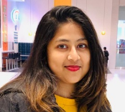
Our group
Danielle do Val
Goncalves Tudeia
(Brazil)
Eduardo Chavez Barrientos
(Mexico)
Jonathan Alberto Calle Zuniga
(Ecuador)
Jonathan Chukwuma Oteh
(Nigeria)
Mostafa Issa Mahmoud Kanaan
(Jordan)
Swetha
Natarajan
(India)

Slide 3

background
Massachusetts, US
#13
state in US with the most residents losing money due to data breach, only in 2020 were almost $100 million
2007
was approved the regulation that requires companies to report data breaches affecting residents' private data
+2X
+5.5X
As of 2022, the average cost of a data breach in the United States was US$ 9.44 million, twice the global average.

Slide 4

PROBLEM
Companies in Massachusetts are facing an exponential increase in data breaches in recent years. Since 2007, a new regulation requires them to report these events, but even so, the numbers show that they do not seem to be more prepared now than a few years ago and are spending a lot money in lawsuits and collective actions brought by residents whose data was stolen.

Slide 5

proposal
Our goal is to support companies in Massachusetts with information about data breaches so they can be better prepared to prevent them and, if they occur, create procedures to mitigate the impact on whose data was stolen.
What are the Top 3 companies that suffered most of the data breaches and what is the trend for these companies?
What type of data stolen through data breaches presents the greatest growth over the years?
What type of data stolen through data breaches has the greatest impact on the population of Massachusetts?

Slide 6
UNDERSTANDING THE DATa
Content
The dataset summarizes the breaches affecting residents’ private data reported to the Office of Consumer Affairs and Business Regulation (OCABR) by companies in Massachusetts, US from 2016 to 2022.
Source
The dataset was collected through the official website of the Commonwealth of Massachusetts. Available at: https://www.mass.gov/lists/data-breach-reports)
Information
The dataset has the information about the data breaches of SSN, Account number, Driver’s licenses, and Credit/Debit numbers affected. Also considers stolen mobile devices and credit monitoring.

Slide 7
UNDERSTANDING THE data
Categorical Data
Feature | Content
Source.Name | Collective report of data breached for the different companies
Organization Name | Different organizations who data has been breach
Breach Type Description | Type of data breaches
Breach Occur at the Reporting Entity? | Provides information if the data breach were reported to institution or not
SSNBreached | If the Social security number has been breached or not
Account Number Breached | If the Account Number of the customer from the institution has breached or not
Drivers Licenses Breached | If the Drivers Licenses of the customer from the institution has breached or not
Credit Debit Numbers Breached | If the Credit/Debit Numbers of the customer from the institution has breached or not
Provided Credit Monitoring | Has the credit monitoring services have been provided
Mobile Device Lost Stolen | Provides information if the mobile is lost or stolen
Unique
Feature | Content
Assigned Breach Number | Distinctive number assigned to a report by OCA
Application Dataset
Numerical Data
Feature | Content
MA Residents Affected | It’s the count of MA resident affected by data breached
Data Encrypted | If the data has been encrypted in data breach
Date Reported To OCA | Reporting date of data breached to OCA

Slide 8
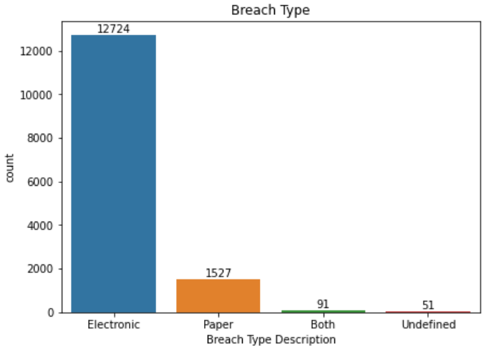
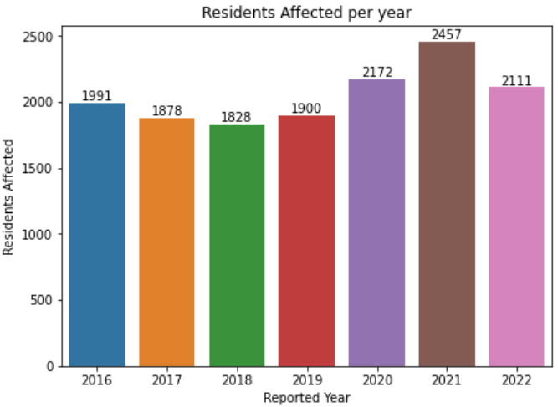
UNDERSTANDING THE DATA
Visualization Examples
File Format
The dataset was created from 7 pdf files grouped in an Excel file (xlsx)
Missing Values
Breach Type Description
Breach Occur at the Reporting Entity?
MA Residents Affected
SSNBreached
Account Number Breached
Drivers Licenses Breached
Credit Debit Numbers Breached
Provided Credit Monitoring
Data Encrypted
Mobile Device Lost Stolen
Groups by
Breach Type
Reported Year

Slide 9
Transforming THE DATA
Deleted 85 rows – NAs in Number of Residents column
Rename column name replacing spaces with _
Create a new column Reported Year so we could do the plots easier
Replaced NAs for “No”
Filtering the data breach for electronic only

Slide 10
references
Solis, S. (2022). In Massachusetts, data breaches, threats on the rise. Axios Boston. https://www.axios.com/local/boston/2022/06/29/massachusetts-data-breaches-threats-on-rise
Mass.gov. (2023). Data breach reports. Massachusetts Government.
https://www.mass.gov/lists/data-breach-reports
Malegislature. (2007). Section 2: Regulations to safeguard personal information of commonwealth residents. The 193rd General Court of the Commonwealth of Massachusetts.
https://malegislature.gov/Laws/GeneralLaws/PartI/TitleXV/Chapter93H/Section2
Thomas, N. (2023). Privacy Litigation 2022 Year in Review: Data Breach Litigation. Morrison Foerster.
https://www.mofo.com/resources/insights/230125-year-in-review-data-breach-litigation
Pagnotta, S. (2022). What’s the cost of a data breach?. Bit Sight.
https://www.bitsight.com/blog/cost-of-data-breach

